Slide 1
雅思无忧直播课程-阅读
精讲精练第一节
主讲老师：朱峰

Slide 2
本节课教学计划
梳理一下之前课程没有讲透的题型
1、填空题中的表格题和识图题
2、判断题中的Y/N题
3、选择题中的多选

Slide 3
先回忆一下填空题的解题理念
1、定段：用尽可能多的名词帮我们定位（数字 符号 大写）
2、定句：前后句（标杆）+本句（适当放大范围）
3、定词：词性（单复数 人地物事）+空前后的近义替换
4、检验：单词数限定（上下限） 名词前的定语一定填
已经在题干中出现的词不能成为答案

Slide 4
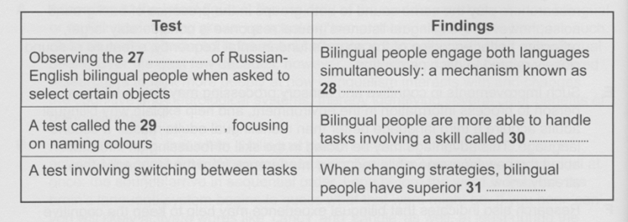
C12T2P3 P48
1 定段
表格题的横栏是最好的分层标识

Slide 5
Test | Findings
Observing the 27 ......... of Russian- English bilingual people when asked to select certain objects | Bilingual people engage both languages simultaneously: a mechanism known as 28 ...........
A test called the 29 ........, focusing on naming colours | Bilingual people are more able to handle tasks involving a skill called 30 ..........
A test involving switching between tasks | When changing strategies, bilingual people have superior 31 ...........

Slide 6
A According to the latest figures, the majority of the world's population is now bilingual or multilingual, having grown up speaking two or more languages. In the past, such children were considered to be at a disadvantage compared with their monolingual peers. Over the past few decades, however, technological advances have allowed researchers to look more deeply at how bilingualism interacts with and changes the cognitive and neurological systems, thereby identifying several clear benefits of being bilingual.

Slide 7
B Research shows that when a bilingual person uses one language, the other is active at the same time. When we hear a word, we don't hear the entire word all at once: the sounds arrive in sequential order. Long before the word is finished, the brain's language system begins to guess what that word might be. If you hear 'can', you will likely activate words like 'candy' and 'candle' as well, at least during the earlier stages of word recognition. For bilingual people, this activation is not limited to a single language; auditory input activates corresponding words regardless of the language to which they belong. Some of the most compelling evidence for this phenomenon, called 'language co-activation', comes from studying eye movements. A Russian-English bilingual asked to 'pick up a marker' from a set of objects would look more at a stamp than someone who doesn't know Russian, because the Russian word for 'stamp', marka, sounds like the English word he or she heard, 'marker'. In cases like this, language co-activation occurs because what the listener hears could map onto words in either language.

Slide 8
C Having to deal with this persistent linguistic competition can result in difficulties, however. For instance, knowing more than one language can cause speakers to name pictures more slowly, and can increase 'tip-of-the-tongue states', when you can almost, but not quite, bring a word to mind. As a result, the constant juggling of two languages creates a need to control how much a person accesses a language at any given time. For this reason, bilingual people often perform better on tasks that require conflict management. In the classic Stroop Task, people see a word and are asked to name the colour of the word's font. When the colour and the word match (i.e., the word 'red' printed in red), people correctly name the colour more quickly than when the colour and the word don't match (i.e., the word 'red' printed in blue). This occurs because the word itself ('red') and its font colour (blue)conflict. Bilingual people often excel at tasks such as this, which tap into the ability to ignore competing perceptual information and focus on the relevant aspects of the input. Bilinguals are also better at switching between two tasks; for example, when bilinguals have to switch from categorizing objects by colour (red or green) to categorizing them by shape (circle or triangle'), they do so more quickly than monolingual people, reflecting better cognitive control when having to make rapid changes of strategy.

Slide 9
定句
填空题的题型中
句子填空、简答一定顺序
段落填空极个别情况乱序
其他题型可能乱序
对于表格题：上下行不乱序，前后列可能乱序

Slide 10
定句的小tip
注意隐蔽的提示点
Called=known as=referred to as=termed

Slide 11
Test | Findings
Observing the 27 ......... of Russian- English bilingual people when asked to select certain objects | Bilingual people engage both languages simultaneously: a mechanism known as 28 ...........
A test called the 29 ........, focusing on naming colours | Bilingual people are more able to handle tasks involving a skill called 30 ..........
A test involving switching between tasks | When changing strategies, bilingual people have superior 31 ...........

Slide 12
B Research shows that when a bilingual person uses one language, the other is active at the same time. When we hear a word, we don't hear the entire word all at once: the sounds arrive in sequential order. Long before the word is finished, the brain's language system begins to guess what that word might be. If you hear 'can', you will likely activate words like 'candy' and 'candle' as well, at least during the earlier stages of word recognition. For bilingual people, this activation is not limited to a single language; auditory input activates corresponding words regardless of the language to which they belong. Some of the most compelling evidence for this phenomenon, called 'language co-activation', comes from studying eye movements. A Russian-English bilingual asked to 'pick up a marker' from a set of objects would look more at a stamp than someone who doesn't know Russian, because the Russian word for 'stamp', marka, sounds like the English word he or she heard, 'marker'. In cases like this, language co-activation occurs because what the listener hears could map onto words in either language.

Slide 13
C Having to deal with this persistent linguistic competition can result in difficulties, however. For instance, knowing more than one language can cause speakers to name pictures more slowly, and can increase 'tip-of-the-tongue states', when you can almost, but not quite, bring a word to mind. As a result, the constant juggling of two languages creates a need to control how much a person accesses a language at any given time. For this reason, bilingual people often perform better on tasks that require conflict management. In the classic Stroop Task, people see a word and are asked to name the colour of the word's font. When the colour and the word match (i.e., the word 'red' printed in red), people correctly name the colour more quickly than when the colour and the word don't match (i.e., the word 'red' printed in blue). This occurs because the word itself ('red') and its font colour (blue)conflict. Bilingual people often excel at tasks such as this, which tap into the ability to ignore competing perceptual information and focus on the relevant aspects of the input. Bilinguals are also better at switching between two tasks; for example, when bilinguals have to switch from categorizing objects by colour (red or green) to categorizing them by shape (circle or triangle'), they do so more quickly than monolingual people, reflecting better cognitive control when having to make rapid changes of strategy.

Slide 14
C Having to deal with this persistent linguistic competition can result in difficulties, however. For instance, knowing more than one language can cause speakers to name pictures more slowly, and can increase 'tip-of-the-tongue states', when you can almost, but not quite, bring a word to mind. As a result, the constant juggling of two languages creates a need to control how much a person accesses a language at any given time. For this reason, bilingual people often perform better on tasks that require conflict management. In the classic Stroop Task, people see a word and are asked to name the colour of the word's font. When the colour and the word match (i.e., the word 'red' printed in red), people correctly name the colour more quickly than when the colour and the word don't match (i.e., the word 'red' printed in blue). This occurs because the word itself ('red') and its font colour (blue)conflict. Bilingual people often excel at tasks such as this, which tap into the ability to ignore competing perceptual information and focus on the relevant aspects of the input. Bilinguals are also better at switching between two tasks; for example, when bilinguals have to switch from categorizing objects by colour (red or green) to categorizing them by shape (circle or triangle'), they do so more quickly than monolingual people, reflecting better cognitive control when having to make rapid changes of strategy.

Slide 15
近义词对的累积
更大程度上取决于平时的笔记，而不是盲目的记忆

Slide 16
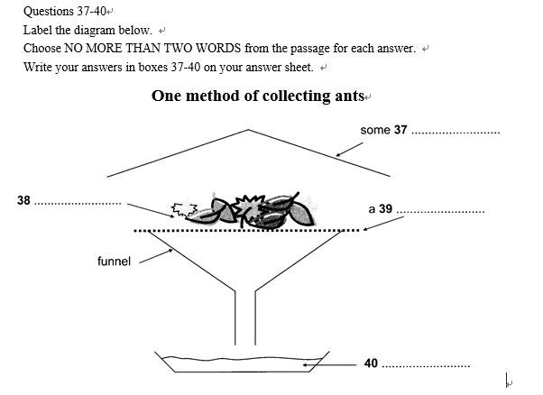
识图题（C8P100）

Slide 17
Many ants are small and forage primarily in the layer of leaves and other debris on the ground. Collecting these species by hand can be difficult. One of the most successful ways to collect them is to gather the leaf litter in which they are foraging and extract the ants from it. This is most commonly done by placing leaf litter on a screen over a large funnel, often under some heat. As the leaf litter dries from above, ants (and other animals) move downward and eventually fall out the bottom and are collected in alcohol placed below the funnel. This method works especially well in rain forests and marshy areas. A method of improving the catch when using a funnel is to sift the leaf litter through a coarse screen before placing it above the funnel. This will concentrate the litter and remove larger leaves and twigs. It will also allow more litter to be sampled when using a limited number of funnels.

Slide 18
题号 vs 方位 哪个更重要

Slide 19
Yes/No 的题究竟比True/False的题难多少
Claim和information的区别在哪里？
阅读理解和阅读的区别在哪里？
通读整段和精确定位的区别在哪里？

Slide 20
Sales representatives like Kim Schaefer work to a very limited budget.
（C6P88）
What was on offer that day was a pair of tickets for a New York musical. But on any given day, what Schaefer can offer is typical for today's drugs rep - a car trunk full of promotional gifts and gadgets, a budget that could buy lunches and dinners for a small country, hundreds of free drug samples and the freedom to give a physician $200 to prescribe her new product to the next six patients who fit the drug's profile. And she also has a few $1,000 honoraria to offer in exchange for doctors' attendance at her company's next educational lecture.

Slide 21
Selling pharmaceuticals is a daily exercise in ethical judgement. Salespeople like Schaefer walk the line between the common practice of buying a prospect's time with a free meal, and bribing doctors to prescribe their drugs. They work in an industry highly criticized for its sales and marketing practices, but find themselves in the middle of the age-old chicken-or-egg question - businesses won't use strategies that don't work, so are doctors to blame for the escalating extravagance of pharmaceutical marketing? Or is it the industry's responsibility to decide the boundaries?
Kim Schaefer's marketing technique may be open to criticism on moral grounds.

Slide 22
The explosion in the sheer number of salespeople in the field - and the amount of funding used to promote their causes - forces close examination of the pressures, influences and relationships between drug reps and doctors. Salespeople provide much-needed information and education to physicians. In many cases the glossy brochures, article reprints and prescriptions they deliver are primary sources of drug education for healthcare givers. With the huge investment the industry has placed in face-to-face selling, salespeople have essentially become specialists in one drug or group of drugs - a tremendous advantage in getting the attention of busy doctors in need of quick information.
The information provided by drug companies is of little use to doctors.

Slide 23
But the sales push rarely stops in the office. The flashy brochures and pamphlets left by the sales reps are often followed up with meals at expensive restaurants, meetings in warm and sunny places, and an inundation of promotional gadgets. Rarely do patients watch a doctor write with a pen that isn't emblazoned with a drug's name, or see a nurse use a tablet not bearing a pharmaceutical company's logo. Millions of dollars are spent by pharmaceutical companies on promotional products like coffee mugs, shirts, umbrellas, and golf balls. Money well spent? It's hard to tell. ‘I've been the recipient of golf balls from one company and I use them, but it doesn't make me prescribe their medicine,' says one doctor.
Evidence of drug promotion is clearly visible in the healthcare environment.

Slide 24
Free samples of new and expensive drugs might be the single most effective way of getting doctors and patients to become loyal to a product. Salespeople hand out hundreds of dollars' worth of samples each week- $7.2 billion worth of them in one year. Though few comprehensive studies have been conducted, one by the University of Washington investigated how drug sample availability affected what physicians prescribe. A total of 131 doctors self-reported their prescribing patterns - the conclusion was that the availability of samples led them to dispense and prescribe drugs that differed from their preferred drug choice.
The drug companies may give free drug samples to patients without doctors' prescriptions.

Slide 25
The bottom line is that pharmaceutical companies as a whole invest more in marketing than they do in research and development. And patients are the ones who pay - in the form of sky-rocketing prescription prices - for every pen that's handed out, every free theatre ticket, and every steak dinner eaten. In the end the fact remains that pharmaceutical companies have every right to make a profit and will continue to find new ways to increase sales. But as the medical world continues to grapple with what's acceptable and what's not, it is clear that companies must continue to be heavily scrutinized for their sales and marketing strategies.
It is legitimate for drug companies to make money

Slide 26
概念强化
题目与原文大量换词 Yes
原文使用比喻举例等修辞 非NG

Slide 27
多选题的难度比单选题要小
C9T2P1 P44
The list below includes factors contributing to classroom noise.
Which TWO are mentioned by the writer of the passage?
A current teaching methods
B echoing corridors
C cooling systems
D large class sizes
E loud-voiced teachers
F playground games

Slide 28
B A preliminary study in New Zealand has shown that classroom noise presents a major concern for teachers and pupils. Modern teaching practices, the organizations of desks in the classroom, poor classroom acoustics, and mechanical means of ventilation such as air-conditioning units all contribute to the number of children unable to comprehend the teacher’s voice. Education researchers Nelson and Soli have also suggested that recent trends in learning often involve collaborative interaction of multiple minds and tools as much as individual possession of information. This all amounts to heightened activity and noise levels, which have the potential to be particularly serious for children experiencing auditory function deficit. Noise in classroom can only exacerbate their difficulty in comprehending and processing verbal communication with other children and instructions from the teacher.

Slide 29
Below are listed some popular beliefs about genius and giftedness.
Which FIVE of these beliefs are reported by the writer of the text?
A Truly gifted people are talented in all areas.
B The talents of geniuses are soon exhausted.
C Gifted people should use their gifts.
D A genius appears once in every generation.
E Genius can be easily destroyed by discouragement.
F Genius is inherited.
G Gifted people are very hard to live with.
H People never appreciate true genius.
I Geniuses are natural leaders.
J Gifted people develop their greatness through difficulties.
K Genius will always reveal itself.

Slide 30
The concept of genius and of gifts has become part of our folk culture, and attitudes are ambivalent towards them. We envy the gifted and mistrust them. In the mythology of giftedness, it is popularly believed that if people are talented in one area, they must be defective in another, that intellectuals are impractical, that prodigies burn too brightly too soon and burn out, that gifted people are eccentric, that they are physical weaklings, that there's a thin line between genius and madness, that genius runs in families, that the gifted are so clever they don't need special help, that giftedness is the same as having a high IQ, that some races are more intelligent or musical or mathematical than others, that genius goes unrecognised and unrewarded, that adversity makes men wise or that people with gifts have a responsibility to use them. Language has been enriched with such terms as 'highbrow', 'egghead', 'blue-stocking', 'wiseacre', 'know-all', 'boffin' and, for many, 'intellectual' is a term of denigration.

